Slide 1
UNIT TWO-Part Three

Slide 2
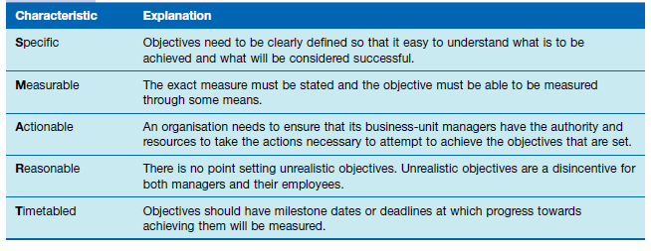

Slide 3
Forecasting
A forecast is a vision of the future. Forecasting is the process of making assumptions about what will happen in the

Slide 4
Contingency planning
Activity undertaken to ensure that proper and immediate follow-up steps will be taken by a management and employees in an emergency.

Slide 5
Scenario planning and contingency planning
Scenario planning is the long-term version of contingency planning.

Slide 6
Benchmarking
The purpose of benchmarking is to find out what other people and organizations are doing very well and then to plan how to incorporate these ideas into your organisation’s operations

Slide 7
Staff planners
As the planning needs of organisations grow, there is a corresponding need to increase the sophistication of the overall planning system itself.

Slide 8
